Slide 1
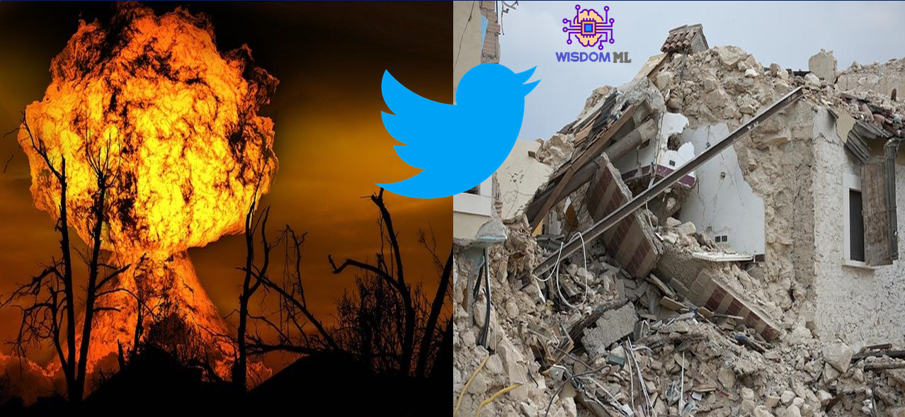
PROJECT ON DISASTER TWEET CLASSIFICATION USING NLP
NAME: S. SUJANA KUMARI AFFILIATION: DIGICROME ACADEMY

Slide 2
PROJECT OVERVIEW
Project Scenario:
Twitter has become an important communication channel in times of emergency. The ubiquitousness of smartphones enables people to announce an emergency they’re observing in real-time. Because of this, more agencies are interested in programatically monitoring Twitter (i.e. disaster relief organizations and news agencies).
Total approach towards the project can be seen on kaggle
Machine Learning approach Deep Learning approach
Project Contents:
Exploratory Data Analysis EDA after Data Cleaning Data Preprocessing using NLP Machine Learning models for classifying Tweets data Deep Learning approach for classifying Tweets data Model Deployment Resources Used Packages : Pandas, Numpy, Matplotlib, Plotly, Word-cloud, Tensorflow, Scikit-Learn, Keras, Keras-tuner, Nltk etc. Word Embeddings : https://www.kaggle.com/danielwillgeorge/glove6b100dtxt

Slide 3
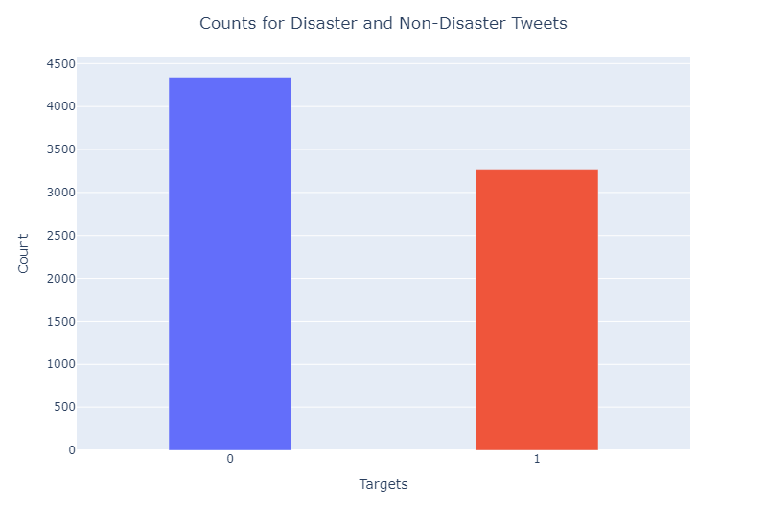
EXPLORATORY DATA ANALYSIS
Visualising Target Variable of the Dataset counts of disaster and non disaster tweets

Slide 4
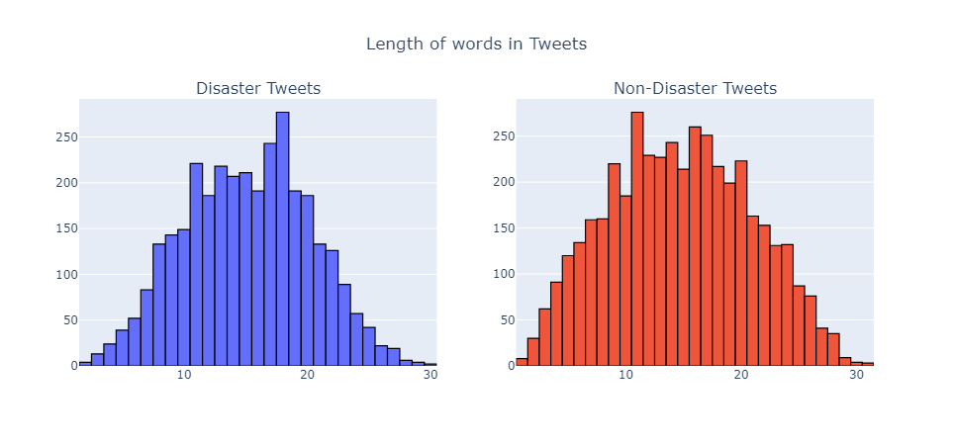
EXPLORATORY DATA ANALYSIS
Target Variable Visualising Length of words in Tweets

Slide 5
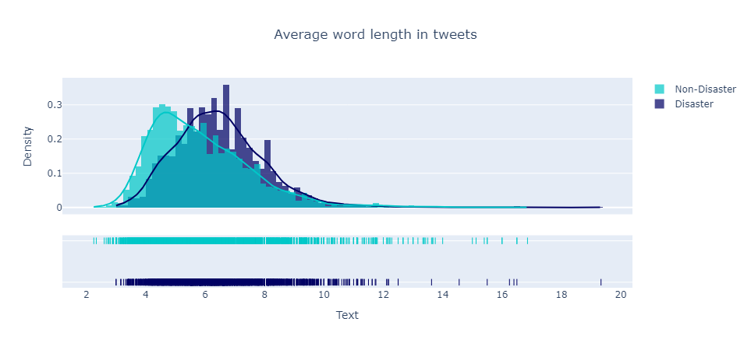
EXPLORATORY DATA ANALYSIS
Tweet Length Visualising Average word lengths of Tweets

Slide 6
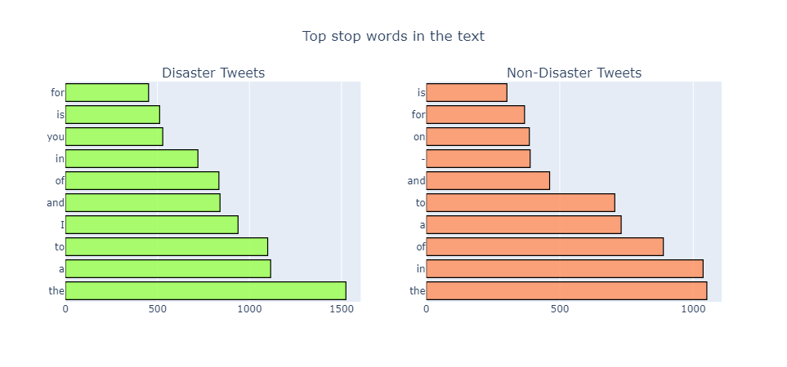
EXPLORATORY DATA ANALYSIS
Average Word Lengths Visualising most common stop words in the text data.

Slide 7
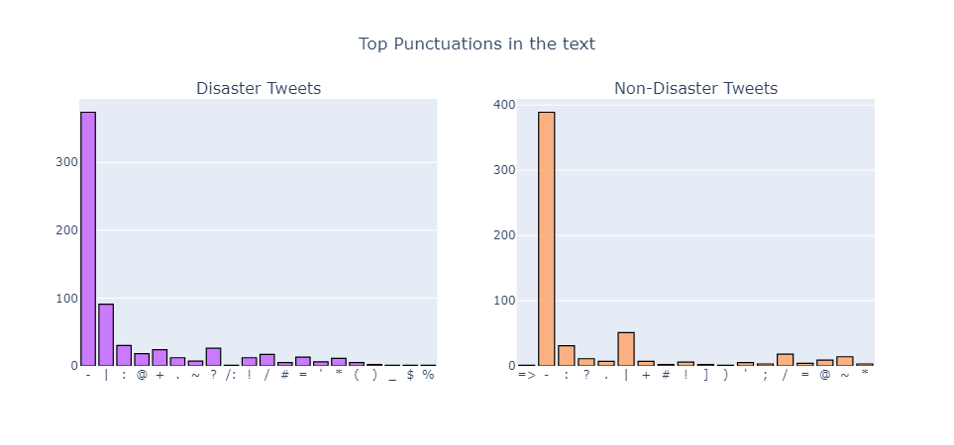
EXPLORATORY DATA ANALYSIS
Stopwords Visualising most common punctuations in the text data

Slide 8
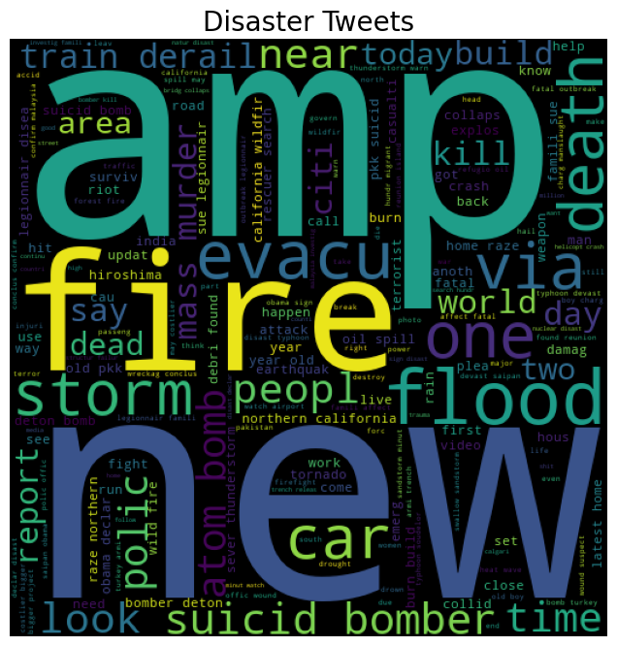
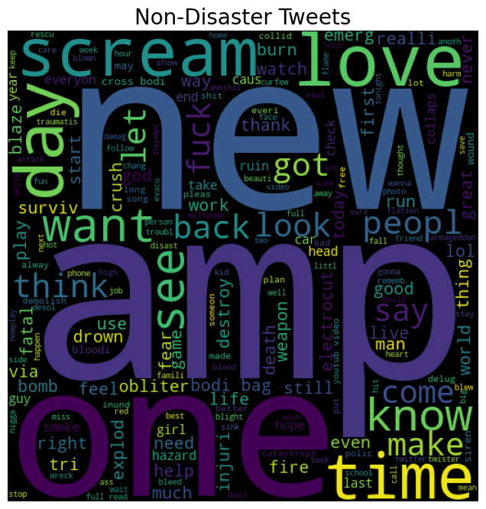
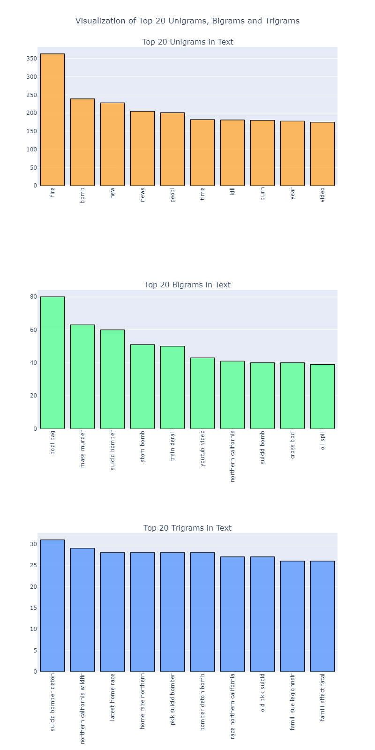
EXPLORATORY DATA ANALYSIS
Visualizing words inside Real Disaster Tweets and real non-disaster tweets. Visualising top 10 N-grams where N is 1,2,3

Slide 9
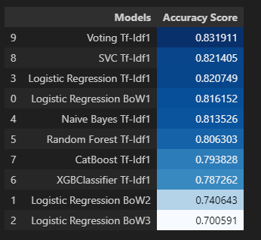
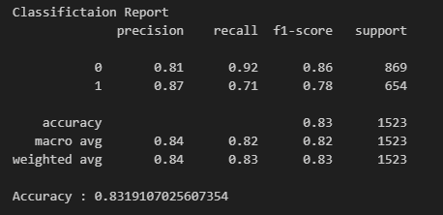
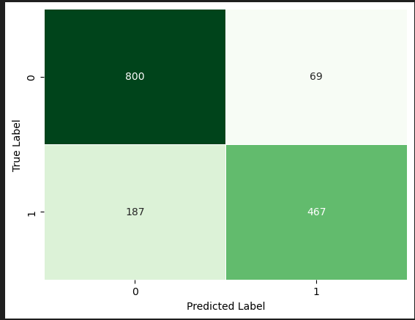
MACHINE LEARNING MODELS FOR CLASSIFYING TWEETS DATA
Machine Learning Models using different n-grams and both Bow and Tf-Idf and visualisation comparing there accuracy
Among all Simple classification models used above Voting Classifier performed best with tf-idf and ngrams = 1

Slide 10
DATA PREPROCESSING USING NLP
Data Preprocessing for ML models is done using two approaches
Bag of Words using CountVectorizer Term Frequency and Inverse Document Frequency using TfidfVectorizer Data Preprocessing for DL models using Tokenization.
Deep Learning approach for classifying Tweets data
Using Glove Word Embeddings of embedding dimension = 100 to get embedding matrix for our DL models For every DL model we create a function and use Keras-Tuner to tune the model Finally we choose Bidirectional LSTM for the Deployment

Slide 11
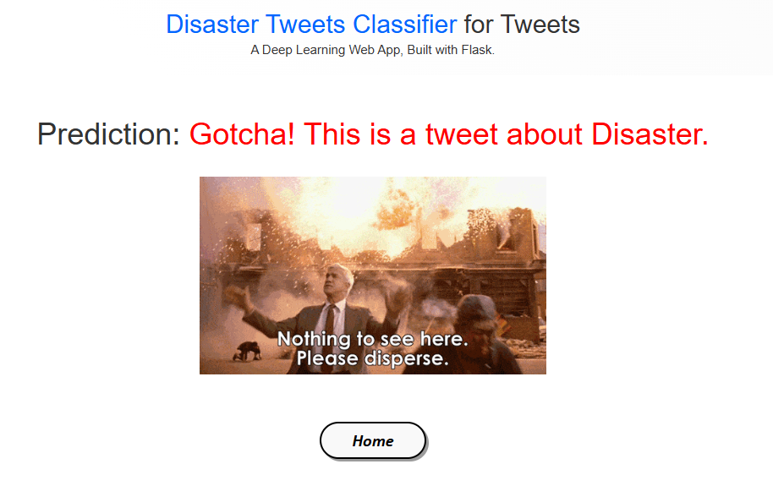
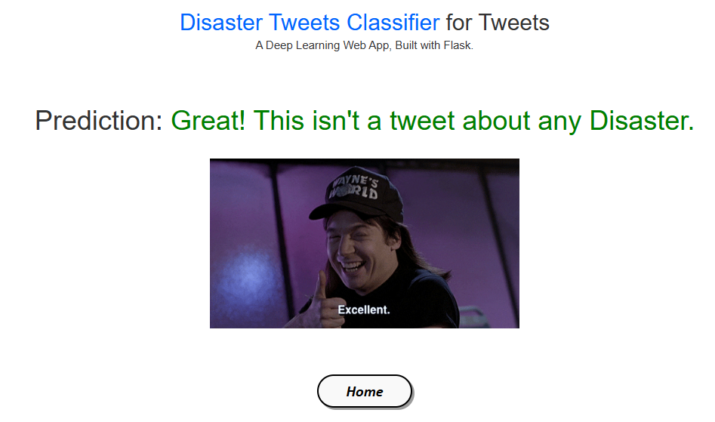
MODEL DEPLOYMENT
Bidirectinal LSTM model obtained from Deep Learning approach is used for deployment Micro Web Framework Flask is used to create web app Deep Learning Web app working Deployment Demo.

Slide 12
THANK YOU

